Slide 1

Chapter 14:
Management 3.0

Slide 2
Software
Engineering?

Slide 3

„command and control“
not suited for todays situation
Social Systems important
In Management
„Management 3.0“
Complex World
Causality not enough

Slide 4
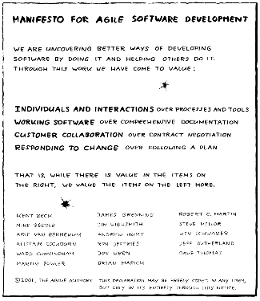

Slide 5
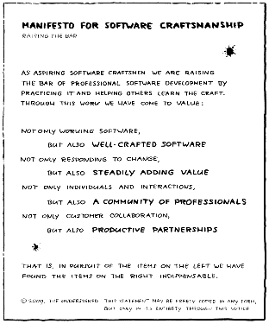

Slide 6
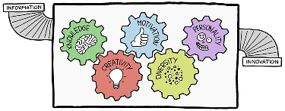

Slide 7
Safety
Play
Variation
Visibility
Edge
Brainstorming
Principles
of
Creativity
Creative Techniques
Energizing People
Extrinsic vs intrinsic
Motivation
Values

Slide 8
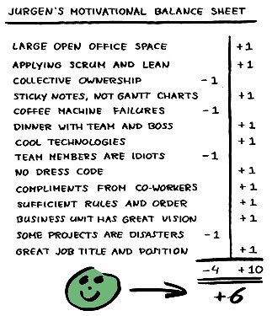

Slide 9

Self-Organization

Slide 10
Mission Statements

Slide 11
Google’s mission is to organize the world’s information
and make it universally accessible and useful

Slide 12
Tesla’s mission is to accelerate the world’s transition to sustainable energy

Slide 13
"SpaceX was founded under the belief that a future where humanity is out exploring the stars is fundamentally more exciting than one where we are not.
Today SpaceX is actively developing the technologies to make this possible, with the ultimate goal of enabling human life on Mars.

Slide 14
Discipline * Skill = Competence
Skipping discipline makes you slower, not faster!

Slide 15
A lot of great stuff …
… but most useful later on in your careers.

